Slide 1

JavaScript Advanced
Course Overview
SoftUni Team
Technical Trainers
Software University
https://softuni.bg

Slide 2
Table of Contents
Introduction
Training & Team
Course Objectives
Course Organization

Slide 3
Have a Question?
sli.do
#js-advanced

Slide 4














SoftUni Diamond Partners

Slide 5

JS Advanced
Course Objectives & Program

Slide 6

JS Advanced – Course Topics
Syntax, Functions and Statements
Arrays
Objects & Classes
DOM
DOM Manipulations

Slide 7
JS Advanced – Course Topics
6. Function Context
7. Advanced Functions
Object Composition
Prototypes and Inheritance
10. Workshop

Slide 8

Trainers and Team

Slide 9
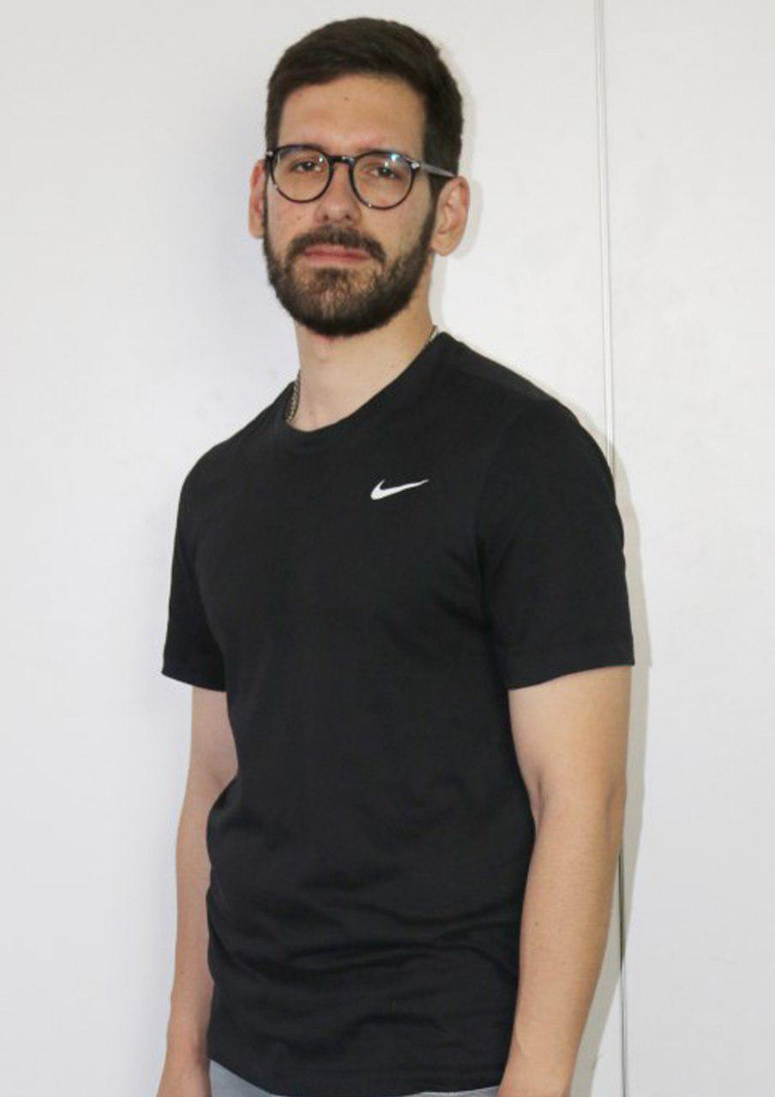
Ilia Idakiev
Software developer-entrepreneur
Co-Founder @ HILLGRAND
Google Developer Expert
Co-organizer of Angular Sofia and SofiaJS / BeerJS
Lecturer at Sofia University (FMI)
"Advanced JavaScript" course

Slide 10
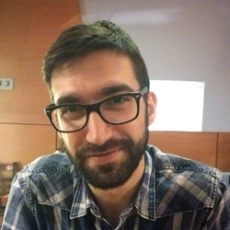
Viktor Kostadinov
Has been Technical trainer for 3 years in the software industry
Former director of the Education Department
Currently the head of the R&D Unit at Software University

Slide 11

Course Details and Schedule
Course Objectives

Slide 12
Targets of the Course
Advanced coding skills for the JS language
Extends the JS Fundamentals course
Covers: Arrays, Objects, Advanced Functions, DOM, Classes, Object Composition, Prototype Chain

Slide 13

Practical Exam
Structure: 3 problems for 4 hours
Exam: June 27, 9:00 - 13:00
Retake: August 12, 14:00 - 18:00
Problems description:
DOM Manipulations
Classes
Inheritance

Slide 14
Theoretical Exam
20 questions for 30 minutes
Multiple-choice with 1 correct answer
English
Automated quiz system
Available online
You can submit your answers just one time

Slide 15


Scoring System for the Course
Theoretical Exam 5%
PracticalExam 90%
Evaluation
Homework 5 %

Slide 16
Questions?
Notes:
16

Slide 17
Trainings @ Software University (SoftUni)
Software University – High-Quality Education, Profession and Job for Software Developers
softuni.bg, softuni.org
Software University Foundation
softuni.foundation
Software University @ Facebook
facebook.com/SoftwareUniversity
Software University Forums
forum.softuni.bg
Notes:
17

Slide 18

License
This course (slides, examples, demos, exercises, homework, documents, videos and other assets) is copyrighted content
Unauthorized copy, reproduction or use is illegal
© SoftUni – https://about.softuni.bg/
© Software University – https://softuni.bg
Notes:
18

